Slide 1

Presenter #2
Luke Abbatessa
Ocean acidification in west-central Florida

Slide 2
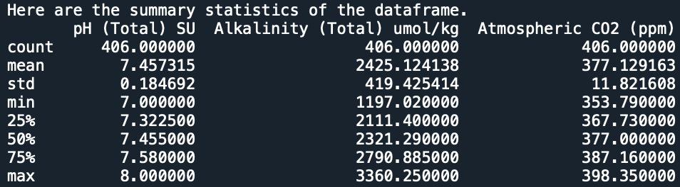
The Dataset
Seasonally-sampled hydrochemical data acquired by scientists from the South West Florida Management District (SWFWMD)
Five coastal springs in west-central Florida (Weeki Wachee, Chassahowitzka, Homosassa, Kings Bay, Rainbow)
Data subsequently obtained by the U.S. Geological Survey (USGS) for further analyses and interpretation
Spans over 20 years (1991-2014)
Dataset I looked at consisted of 12 columns, however I chose to focus on five (Site Id, pH (Total) SU, Alkalinity (Total) umol/kg, Atmospheric CO2 (ppm), Year)
-I added the Year column through string splicing of the column Year_Season in the original dataset
Shortcoming: the dataset only goes up to 2014; ocean acidification and environmental processes in general tend to be very fluid → data may not be the most accurate

Slide 3
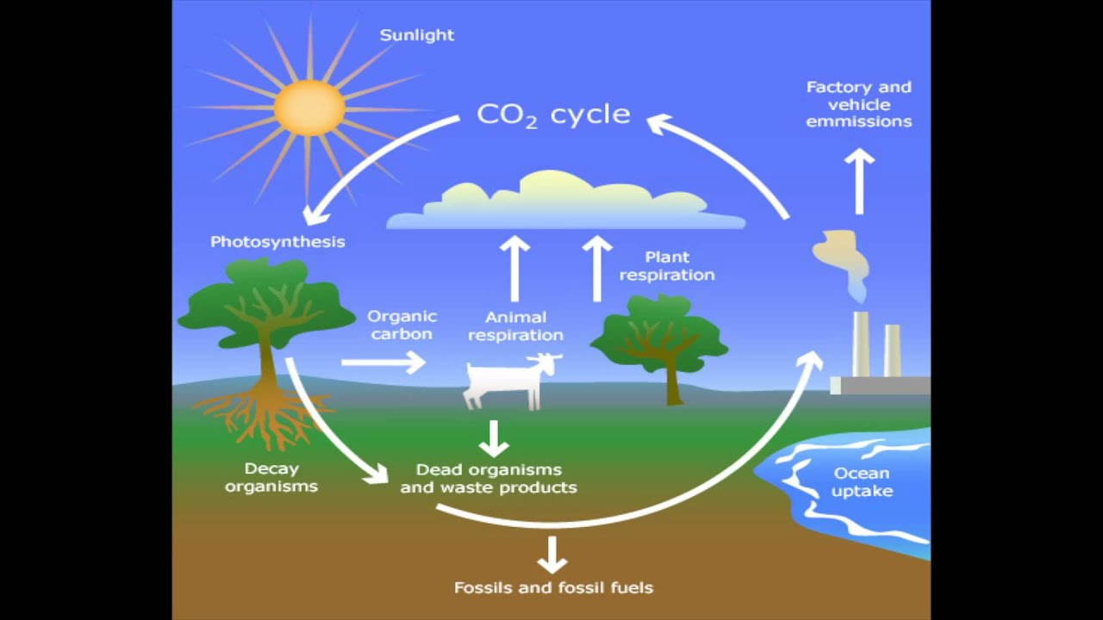
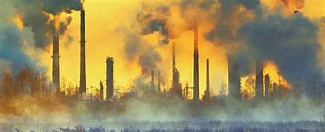

The Question
For each of the five spring study sites, what are the predicted relationships between atmospheric CO2 and pH as well as between pH and alkalinity in the coming years, regardless of season?
Significance:
These findings can:
-help scientists and the general public get a better idea of the effects of the carbon cycle on our oceans
-highlight anthropogenic (human-caused) impacts on the environment and its biodiversity
-hopefully convince people to live more sustainable lives and limit their personal emissions of fossil fuels (i.e. riding a bike instead of driving a car)

Slide 4
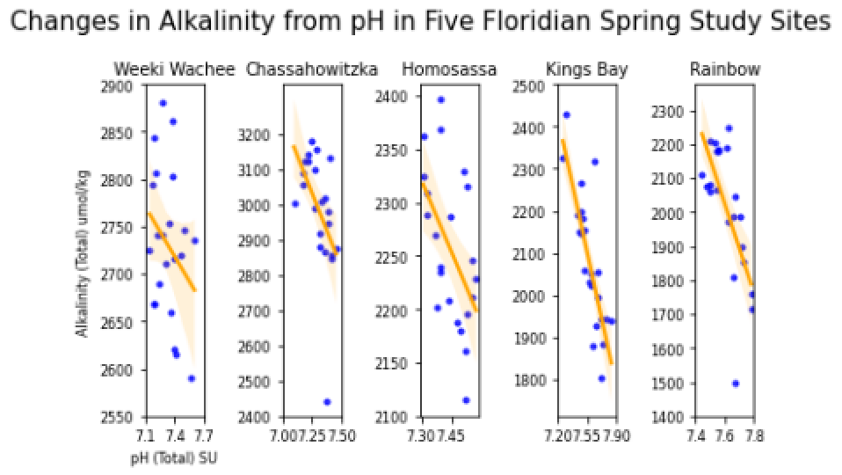
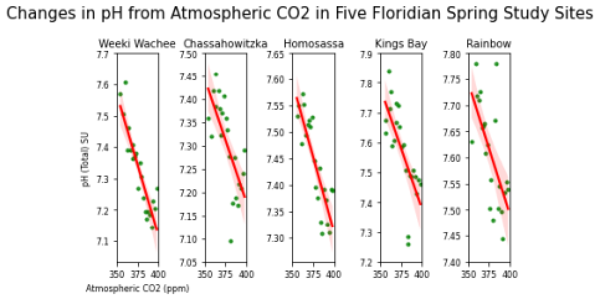
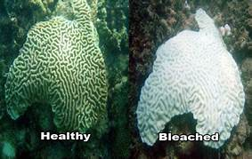
The Insight
Right figure:
In each of the study sites, although the correlation between pH and alkalinity may not be as strong, it is still observably negative
If we were to look over a span of 100 years, we’d see that, for each of the five sites, the alkalinity transitions from positive to negative
-this means in the water is some amount of mineral acidity
Left figure:
In each of the study sites, there is a considerably strong negative correlation between atmospheric CO2 and the pH of the water representative of the site
If we were to look over a span of 100 years, we’d see that, for three of the five sites, the pH drops by 1
-this could mean a significant shift in the conditions of the water that certain species call their habitat
Looking bigger picture…
Since the Industrial Revolution, atmospheric CO2 has increased due to processes like fossil fuel emissions
Our oceans have absorbed some of this CO2; chemical reactions have led to the release of hydrogen ions and thus acidity
Acidity → decrease in carbonate ions → coral bleaching and death
Next steps:
Look deeper into these relationships for other areas of Florida/other states/other countries
Use other machine learning models to make similar predictions regarding the environment

